Slide 1
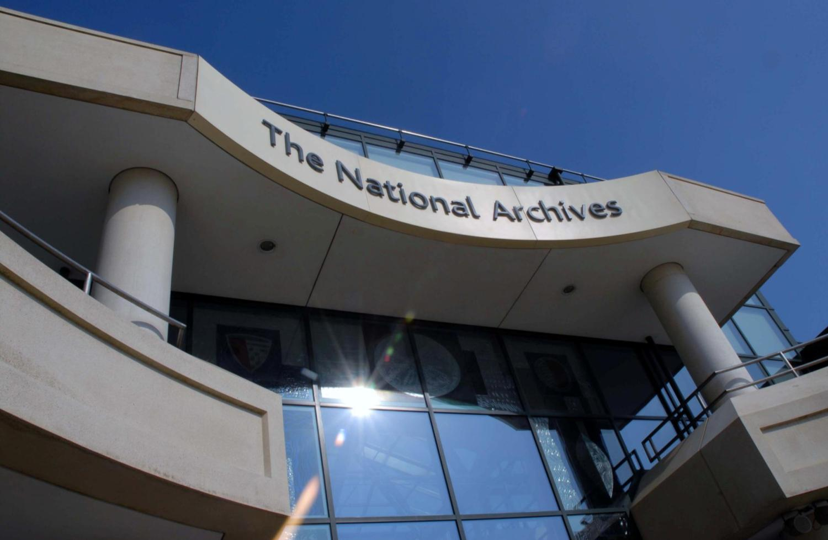
Modelling for decision making: Simulating the building environment
Oliver Morley
Chief Executive and Keeper
The National Archives (UK)

Slide 2
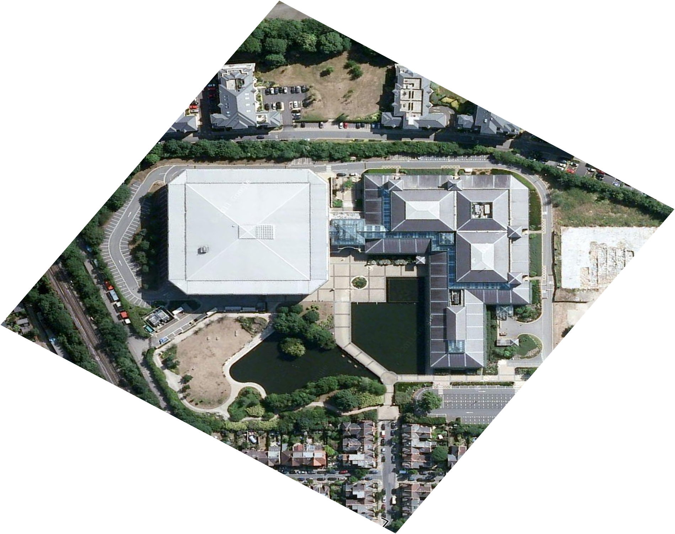
Context - 2009
National
Reducing reliance on fossil fuel
Revised Environmental Standards
TNA
No economical solution to reducing physical provision through digitisation
Other physical solutions unlikely to work financially or for users
Conclusion – Make Kew work

Slide 3
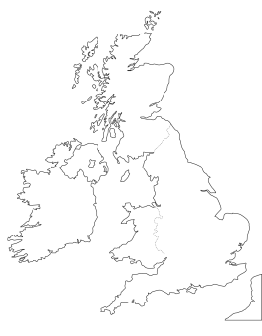




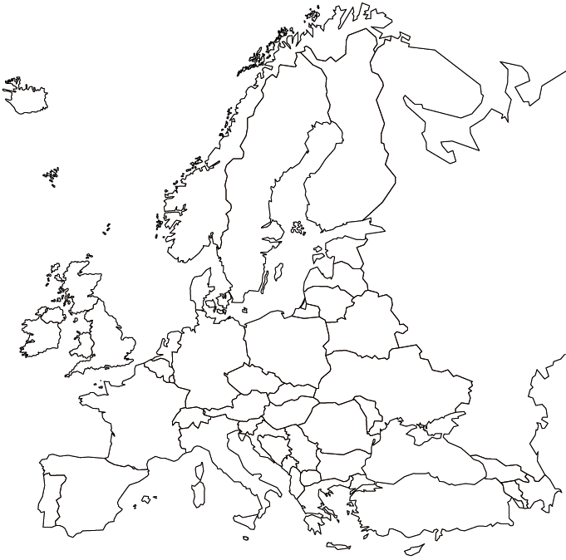

Standards and guidelines
PAS 198:2012 Specification for environmental conditions for cultural collections
PD 5454: 2012 Guide for the storage and exhibition of archival materials
by merging BS5454:2000 and PD0024
45%-60% RH ±5%
16-19ºC ±1ºC
40%-60% RH
16-25ºC
Bizot Group
40%-60% RH, less than 10%/24h
16-25ºC
CEN/TC 346 (Standard under development, estimated publication date is 2013/14)

Slide 4

Publicly Available Specification 198

Slide 5


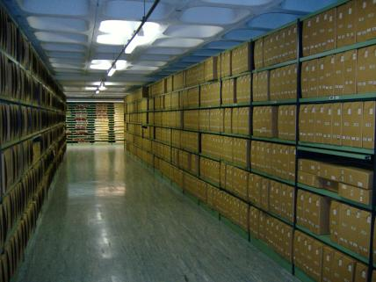

Building Environment Simulation (BES)
The research question
Can we provide appropriate environmental conditions (relative humidity and
temperature) for the collection to prolong its lifetime, and meet government
targets on CO₂ emission and energy usage?
Building envelope
Relative humidity
Temperature
Outdoor environment
HAMT
Air/Con
Centre for Sustainable Heritage
The Bartlett School of Graduate Studies
University College London

Slide 6
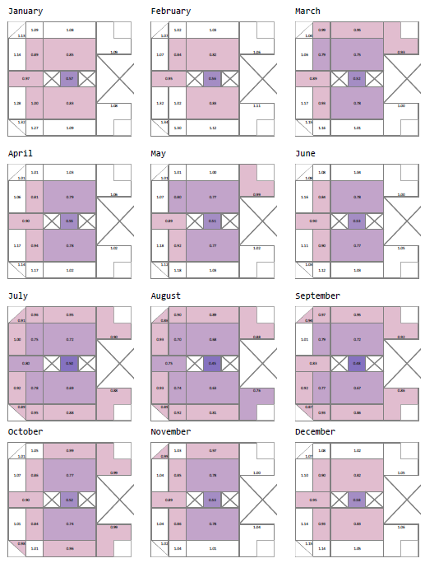
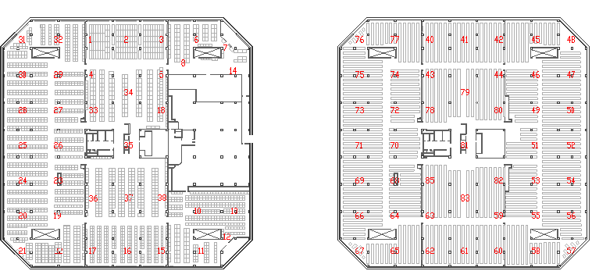

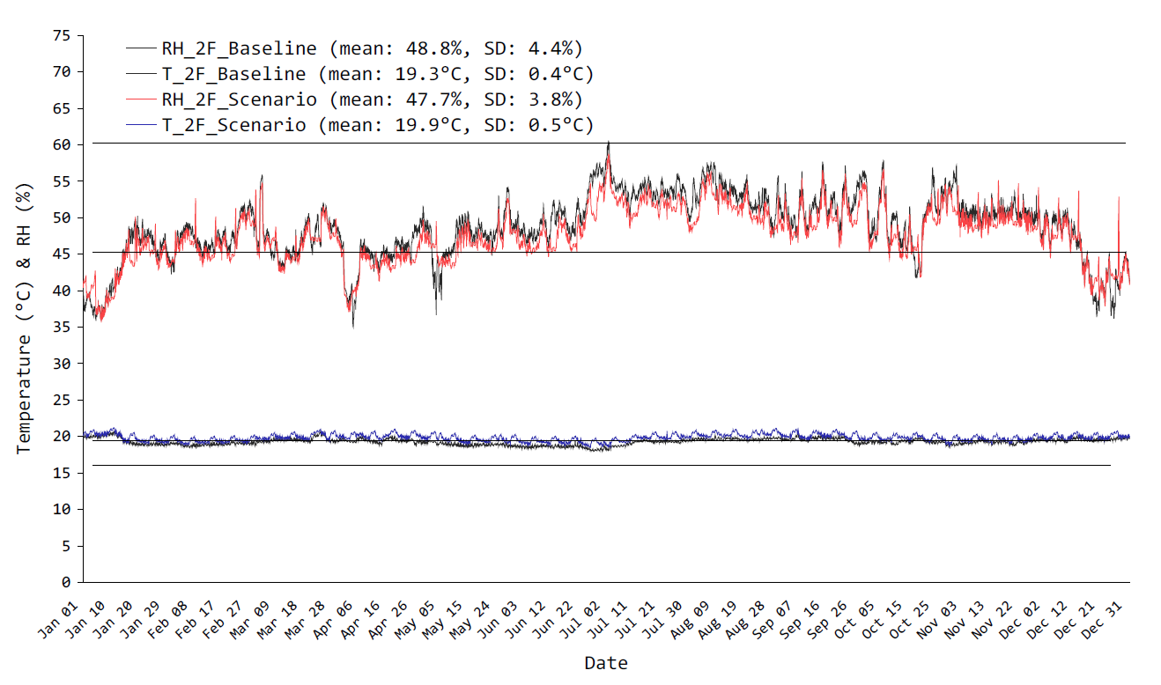
Computer modelling
  Building Environment Simulation Project (BES)
Model software
What-if scenarios
Centre for Sustainable Heritage
The Bartlett School of Graduate Studies
University College London

Slide 7
Summary of results
Demand for cooling is 70% of total energy load
Powering down HVAC over the weekend: Up to 22% saving without affecting preservation environment
Seasonally adjusted HVAC set points: Up to 43% saving with improved quality of preservation environment
Increasing roof insulation and other myths: No net change
The capacity of the archival material to moderate conditions is marginal whilst HVAC is in operation
Projected climate change will increase operation energy load by 15% by 2050 and 24% by 2080
Under certain conditions the building can maintain the environment without HVAC system in April, May and December

Slide 8

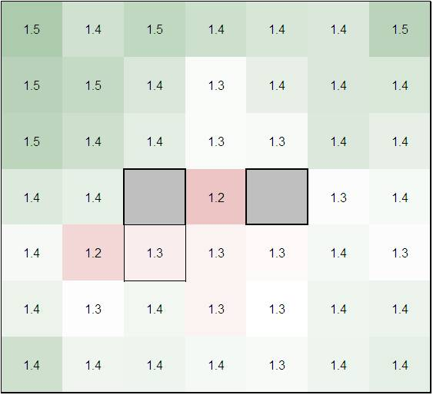
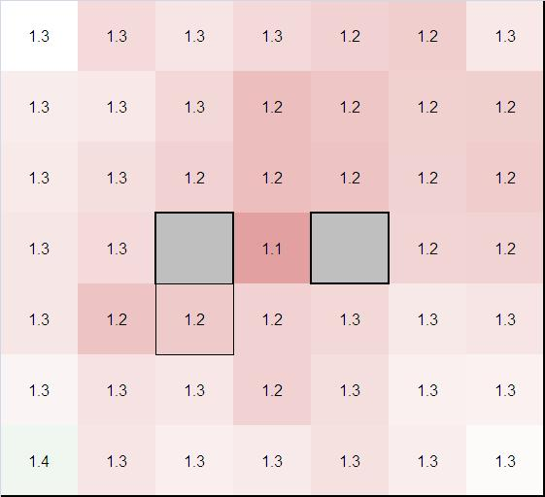
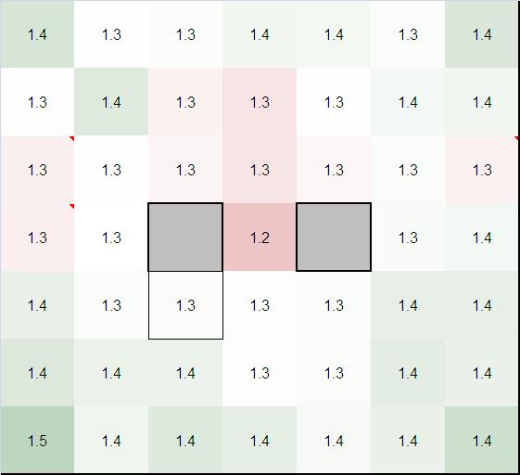
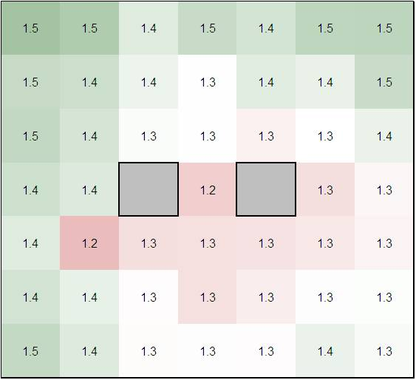

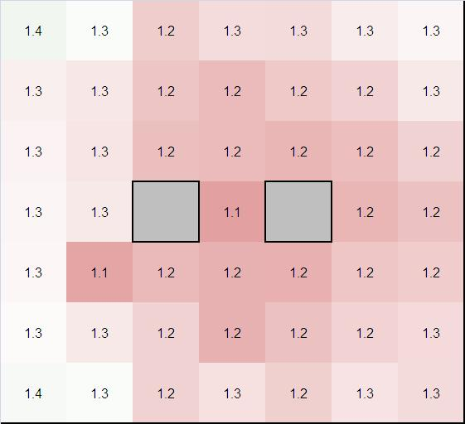
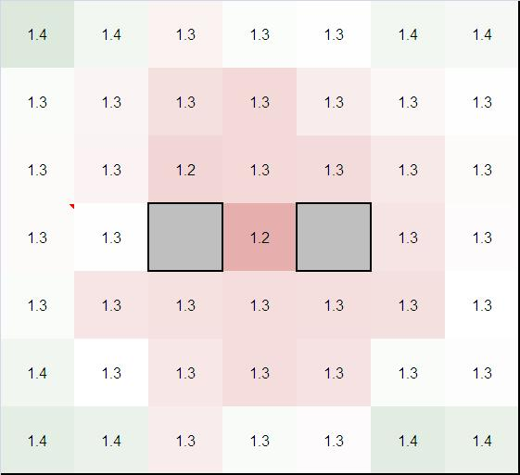
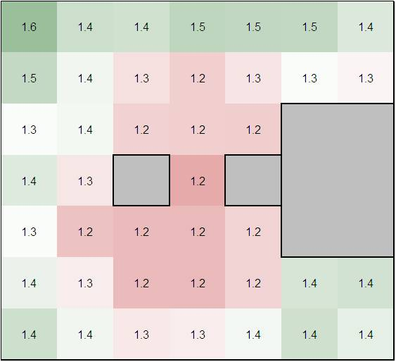
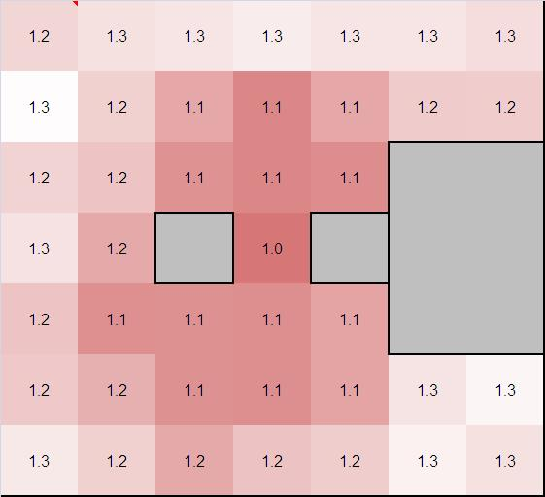
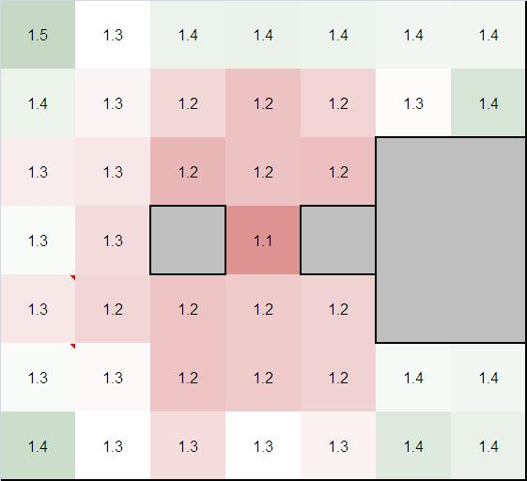

Permanence maps – Q1
Mould Hazard
4th Floor
3rd Floor
2nd Floor
2008
2009
2010
2011

Slide 9
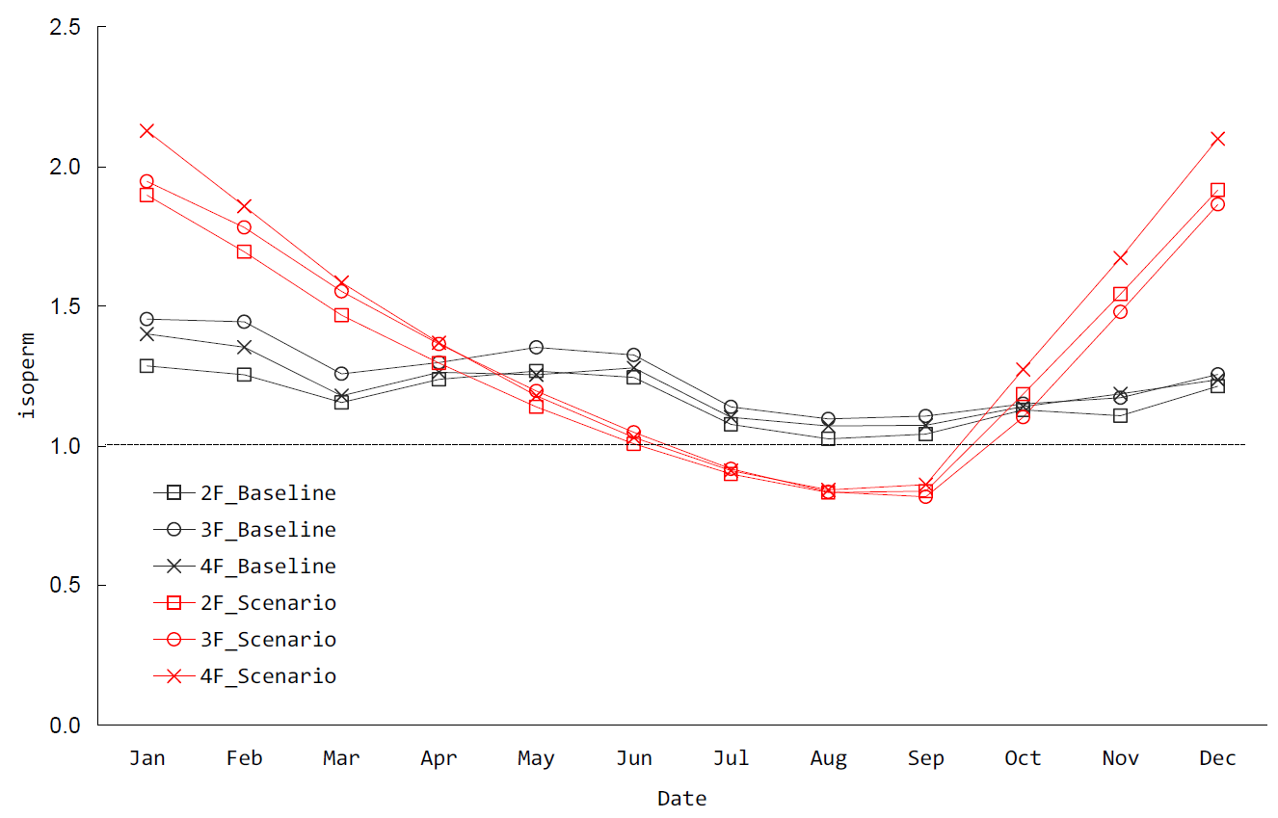

Slide 10












System upgrades
2007-2008 | Q2 Replaced failed repository chillers
2008-2009 | Q1 Installation of repository fresh air dehumidification pre-treatment
2009-2010 | Q1&2 Installation of voltage optimisation equipment
 | Q1&2 Installation of Energy Monitoring System
 | Q1&2 Building Management System upgrade
 | Cooling Tower refurbishment
2010-2011 | Q1 Chiller replacement
 | Q1 Boiler replacement
 | Q1&2 Building Management System upgrade (phase 2)
2011-2012 | Q1 Humidification upgrade
Environmental Assessment

Slide 11
Implementation
 | Before | After
RH and T set points | Fixed | Seasonally adjusted
Allowable fluctuations (dead band) | Fixed | Variable
Operational schedule | On 24/7 | Weekend shutdown Weeknights shutdown
Chilled water temperature | Fixed | Variable in Q1
Fresh air intake | On 24/7 | Off when not needed
Chillers operation | On 24/7 | Off when not needed
7A Dehumidification Transfer of photographic material into 7A | Chilled water | Desiccant wheel

Slide 12
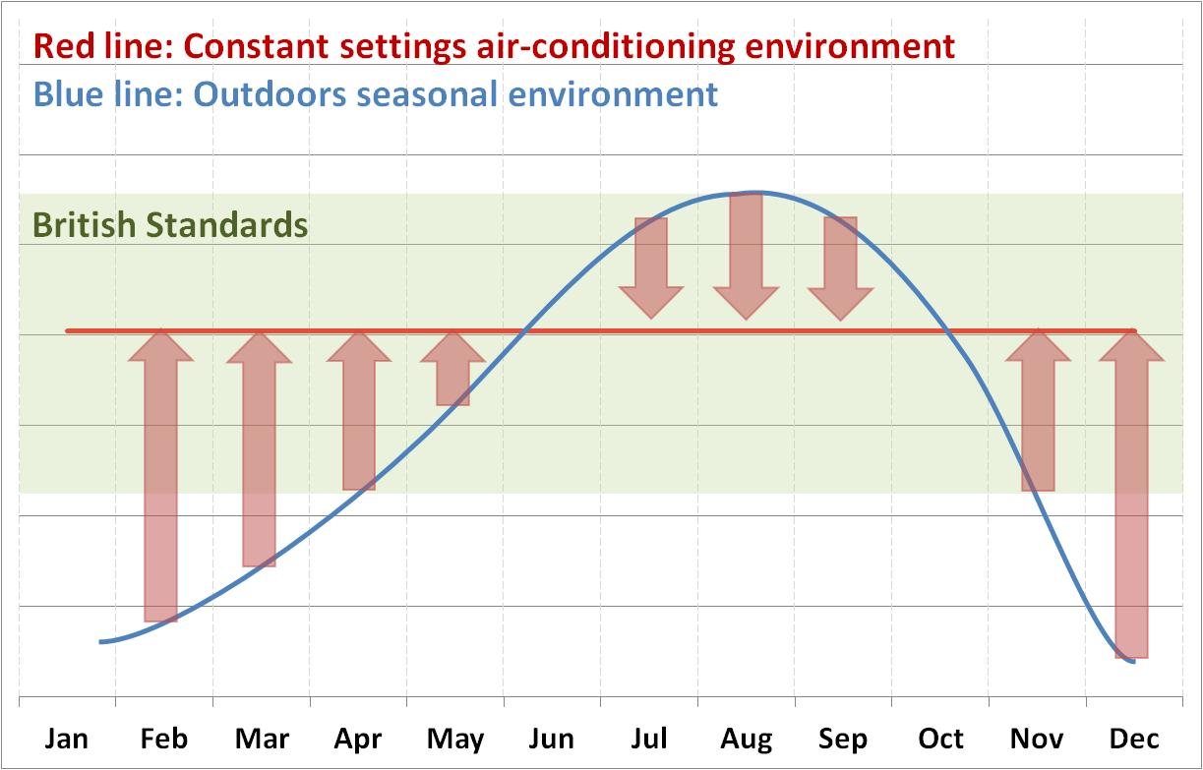
Notes:
This image represents traditional close control, fixed setpoint environmental control

Slide 13
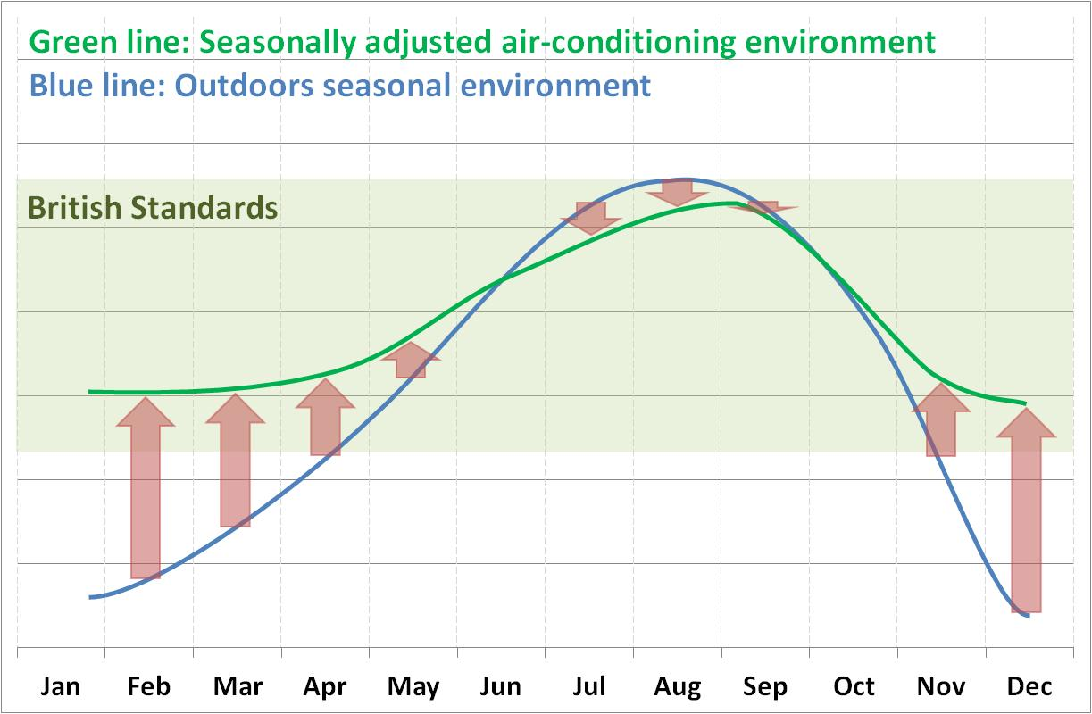
Notes:
This image represents seasonal drift with adjusted setpoint control.
Note that conditions still remain within the recommendations of the BS5454/PD5454
If you consider the red arrows as energy inputs to meet control conditions, you can see that this control strategy requires significantly less energy than traditional close control, fixed set point methods
It should also be noted that this control strategy sets the foundation for plant switch off at weekends and overnight, which is our other key method for saving energy while still maintaining the records

Slide 14
Seasonal Set Points – Potential for Savings
  £175k of energy savings in 2011-12 against 2010-11
  14% reduction in CO₂ emissions in 2011-12 compared with 2010-11
  27.3% reduction in CO₂ emissions against a 2009-10 baseline (target of 25% by 2015 now met)
  Display Energy Certificate (DEC) rating improved from G to D

Slide 15
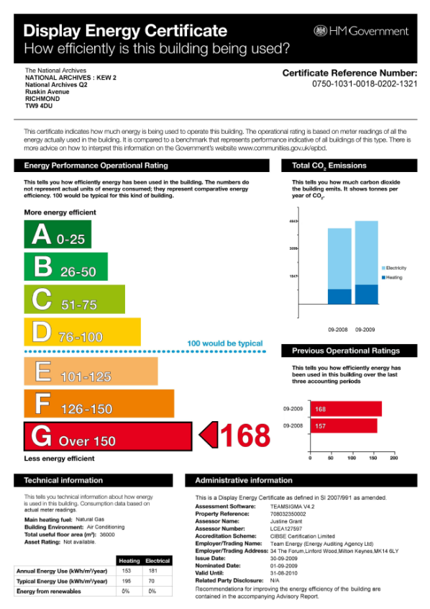
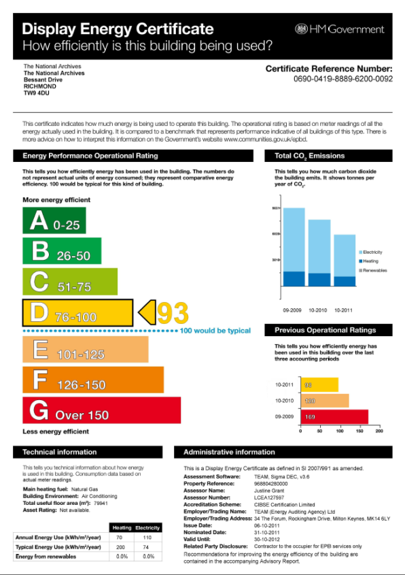
Display Energy Certificates - Kew
2009
2011

Slide 16
The Estates Development Programme
Aim: To oversee a programme of replacement and maintenance projects, prolonging the life of the Estate, investing in new and sustainable technologies and ensuring VfM
Membership: A collaborative Board, including the Director O&S (SRO) and Director HR&OD (Senior User), Senior Managers and Project Managers from Estates and ETDE, Procurement, Finance, Strategic Projects & Communications
Scope: 56 separate projects across development and maintenance. At the height of the programme, 85 contractors were on site
Budget: £13 million across FY 08/09-11/12 (£11.9 million capital, £1.1million Revenue)
Methodology: All projects were assessed against pre-determined and weighted business criteria and prioritised using a dynamic Forward Maintenance Register (FMR)

Slide 17
Where did the money go?
Notes:
The chart shows the £13 million programme by project/work type.
It should be noted that each project was allocated a main work type to produce this analysis – in reality a number of projects contain elements of 2 or more of these work types

Slide 18
How did we do? Carbon/Energy savings
All government carbon targets exceeded ahead of deadlines, including SOGE (12.5% by 10-11); PM’s (10% by May 11) & Greening Government (25% by April 15)
Carbon reduction 27% (at 31 Mar 12)
Energy consumption reduced by 24%
~9,000 tonnes CO₂ saved over 4-years
Exposure to financial risk from carbon taxes and future energy supply cost fluctuations mitigated
£1.6M savings banked since 09-10
DEC rating reduced from G to D
It is worth noting, following SSE’s announcement of 9% rises in energy charges, that future savings will increase if energy cost and taxes rise, as expected.

Slide 19
Estates 30 year life-cycle planning
CC
CC

Slide 20
In summary
Success Criteria | Achieved? | Comment
Statutory responsibilities met | Fully | Fire, H&S, Environmental and Equality requirements met, with only one minor accident and no RIDDOR.
Safety, security and preservation of records enhanced | Partially | Whole Life Costing approach i.a.w. PD5454. Further enhancements to BMS’ planned for 12/13.
Energy savings & carbon emissions reduced | Exceeded | £1.6m energy savings to date; 27% carbon reduction & ~9,000 tonnes of carbon saved.
Backlog maintenance burden addressed and future investment spend ‘smoothed’ | Fully | 30-year plan developed, smoothing out future expenditure and saving £54 million.
VfM | Fully | Programme delivered on budget/schedule; TEA £2.84; negotiated reductions in management fees, savings in management and procurement working through FM partner.
Reputation protected and enhanced | Fully | No material issues with customers, staff, trade unions or neighbours.
Facilities for staff and public improved | Partially | Further improvements, such as disabled access ramps planned.
Ongoing maintenance and operating cost efficiencies | Partially | £1.6m energy savings. Reduced maintenance spend due to efficient plant is offset by costs associated with the sophistication of new technology solutions.
The operational life of the Kew site prolonged beyond 2020 | Fully | Extended ‘design life’ of Q1 beyond 2020 and of Q2 to 2042 with a ‘smoothed’ 30-year life-cycle plan.
Technology infrastructure and resilience improved | Fully | ICT server room standby power, improved cooling and free cooling, Dark Archive, DRI room etc.

